Slide 1
Catholic Mexican Wedding

Slide 2
The most common option for marriage in Mexico is performing a catholic ceremony.
Catholicism is the dominant religion in Mexico. Around 83% of the population is catholic.
Most of the catholic people will likely perform a catholic wedding.
However, there are other rituals in Mexico to symbolize the unión of a couple
Mayan Weddings. The weddings generally take place on a beach or archeological sites in destinations located in the Mayan region of Mexico, such as Cancun.
Aztec Weddings. Before the Spanish conquered Mexico (1521). The Aztecs (Mesoamerican culture) had their own rituals which are followed by some ethnic groups in Mexico nowadays.

Slide 3
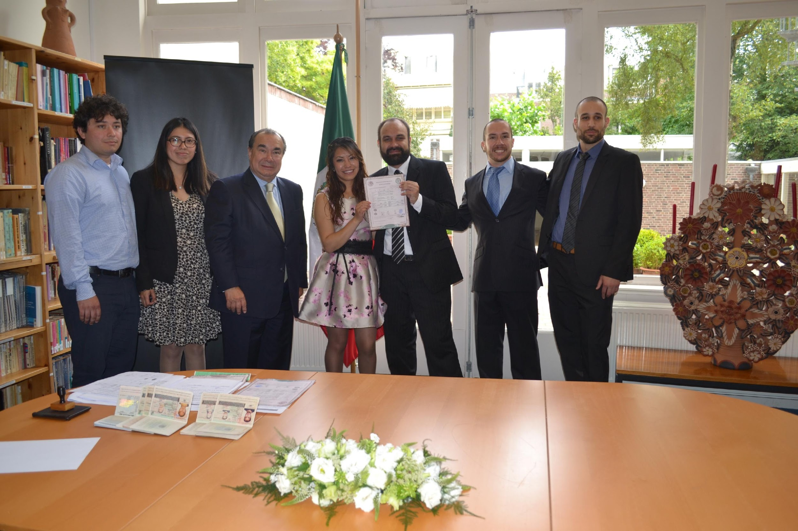
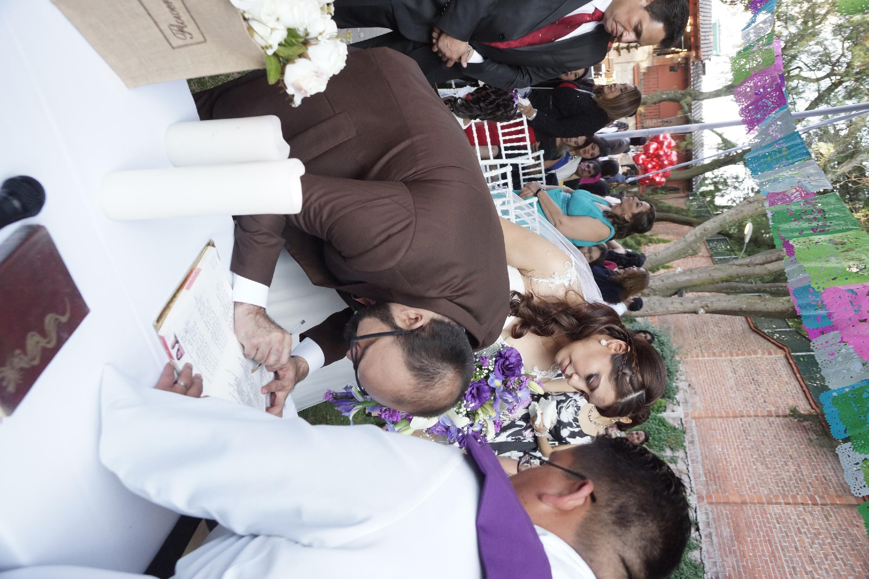
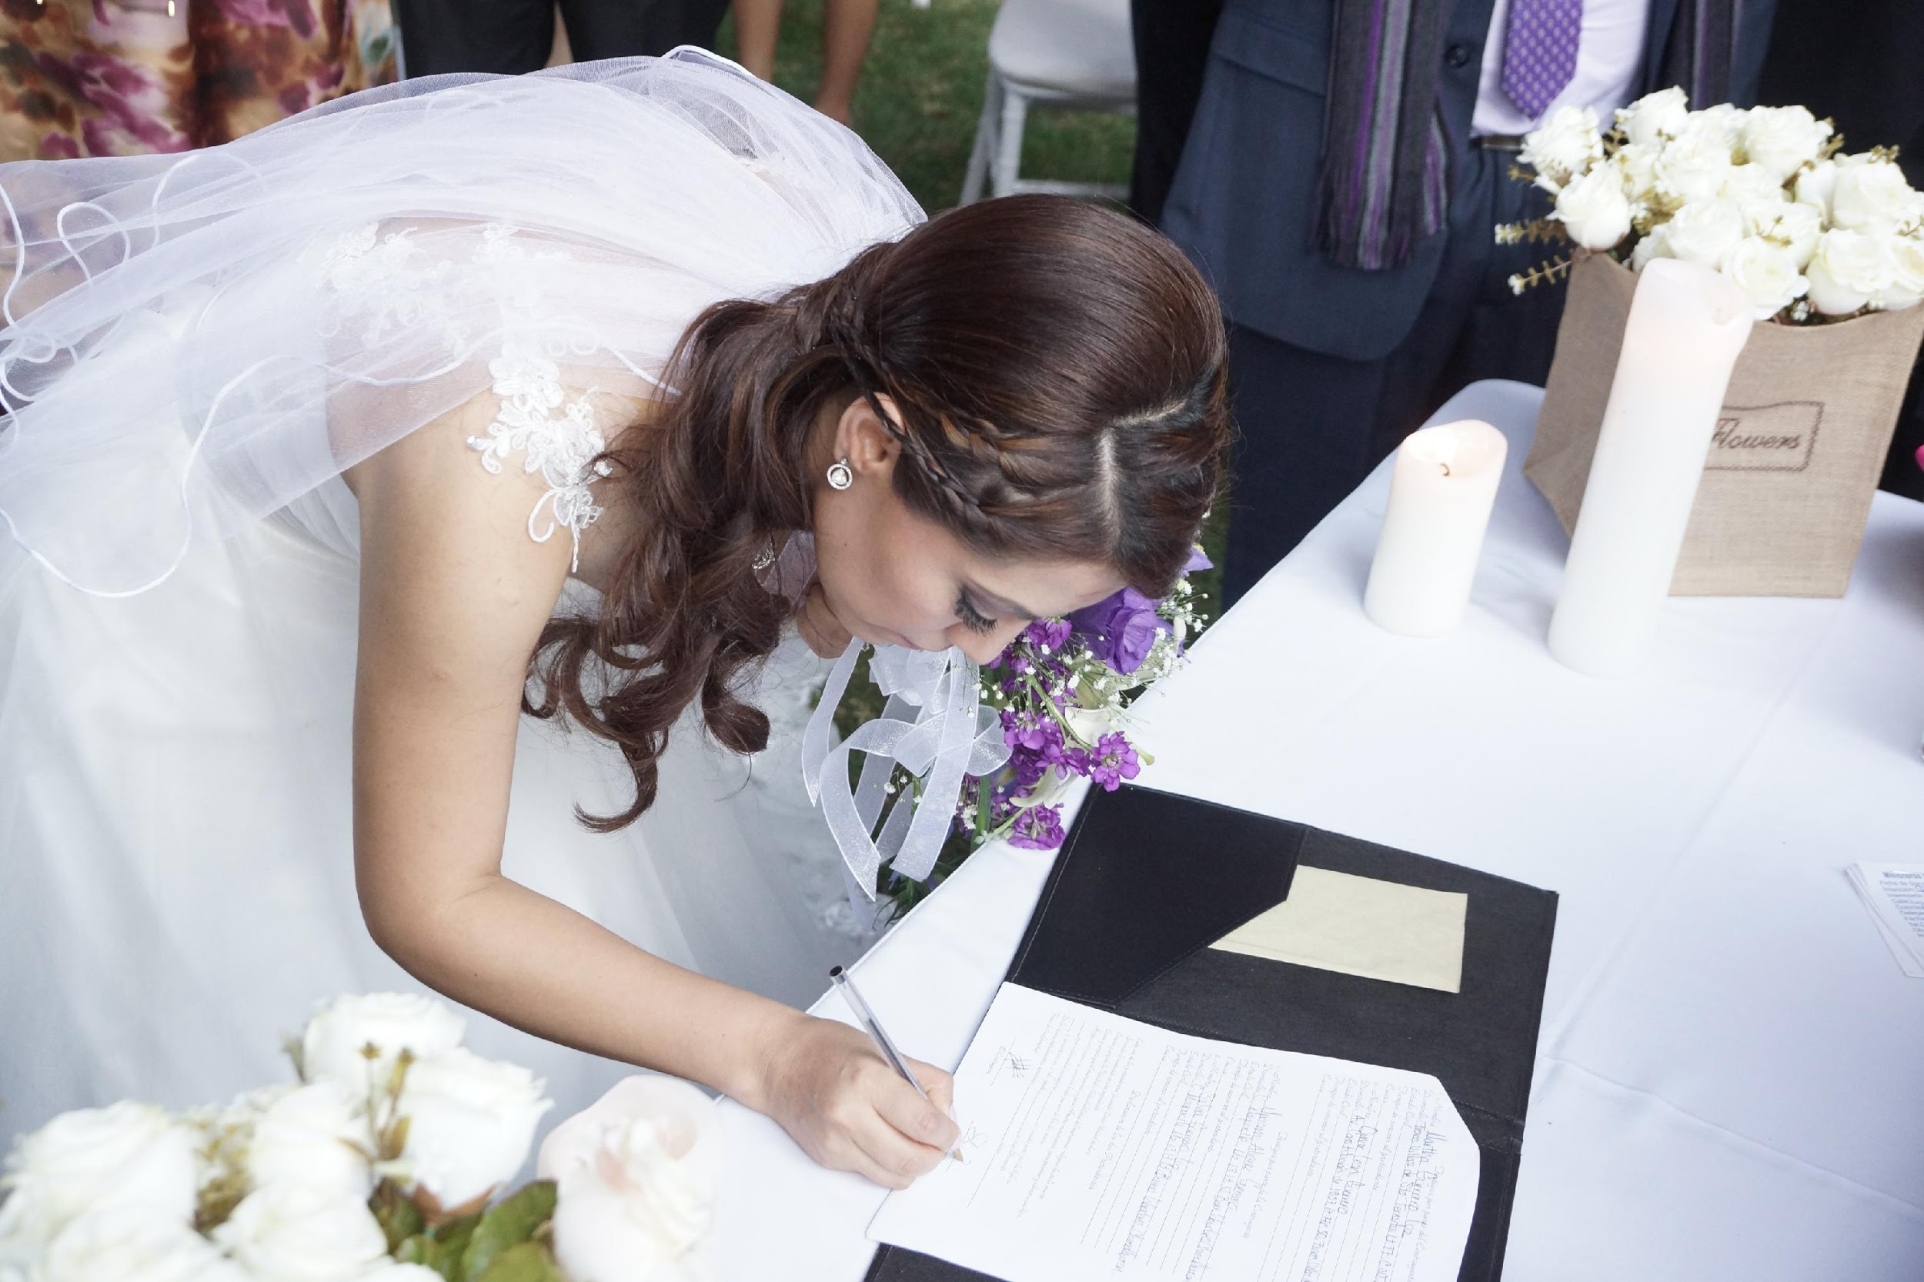
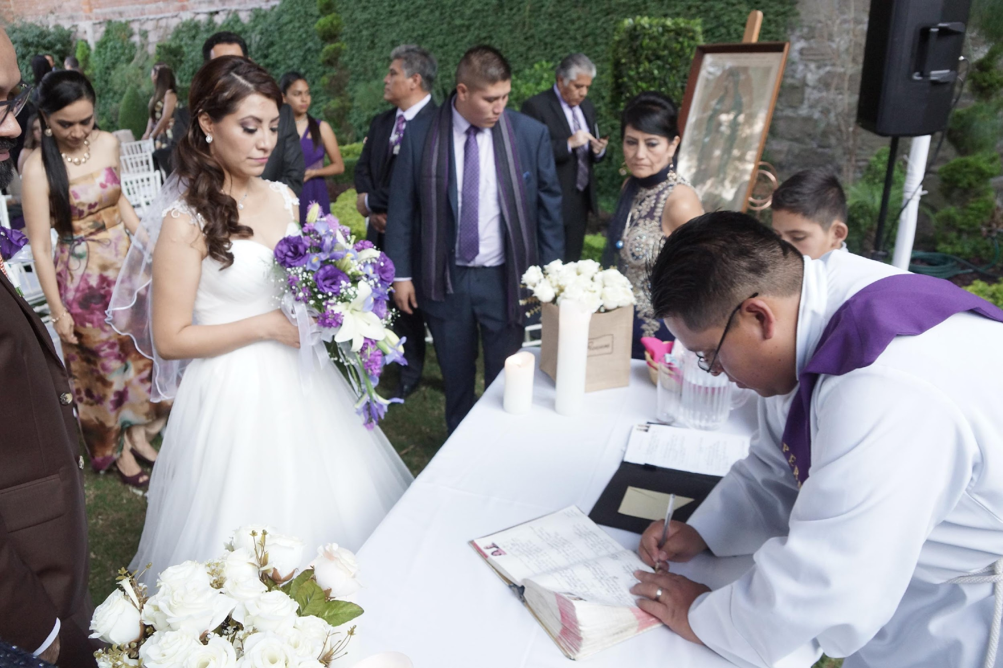
Catholic ceremony
Legal marriage
The legal union of the couple takes places at the municipality.
It takes 30 min – 1 hr.
The union requires 4 witnesses.
To get married, legally, you do not need to be married by the religion (catholic ceremony) and vice versa.
Generally, in the legal wedding there is no exchange of rings.
You will get your marriage certificate!
Some couples choose to be married by religion (catholic ceremony) but not legally.
The ceremony is 1 hour long.
There are religious pre-requisites for the couple to perform a catholic ceremony. These are religious pre-requisites, such as Baptism and First Communion.
There is a committee of 8 – 10 Godparents.
The role of the godparents are different to the bridesmaids or groomsmen, although they can be the same person.
You will get your catholic marriage certificate. These certificate is not really used for any purpose internationally.
Jul 2015
Dec 2016

Slide 4
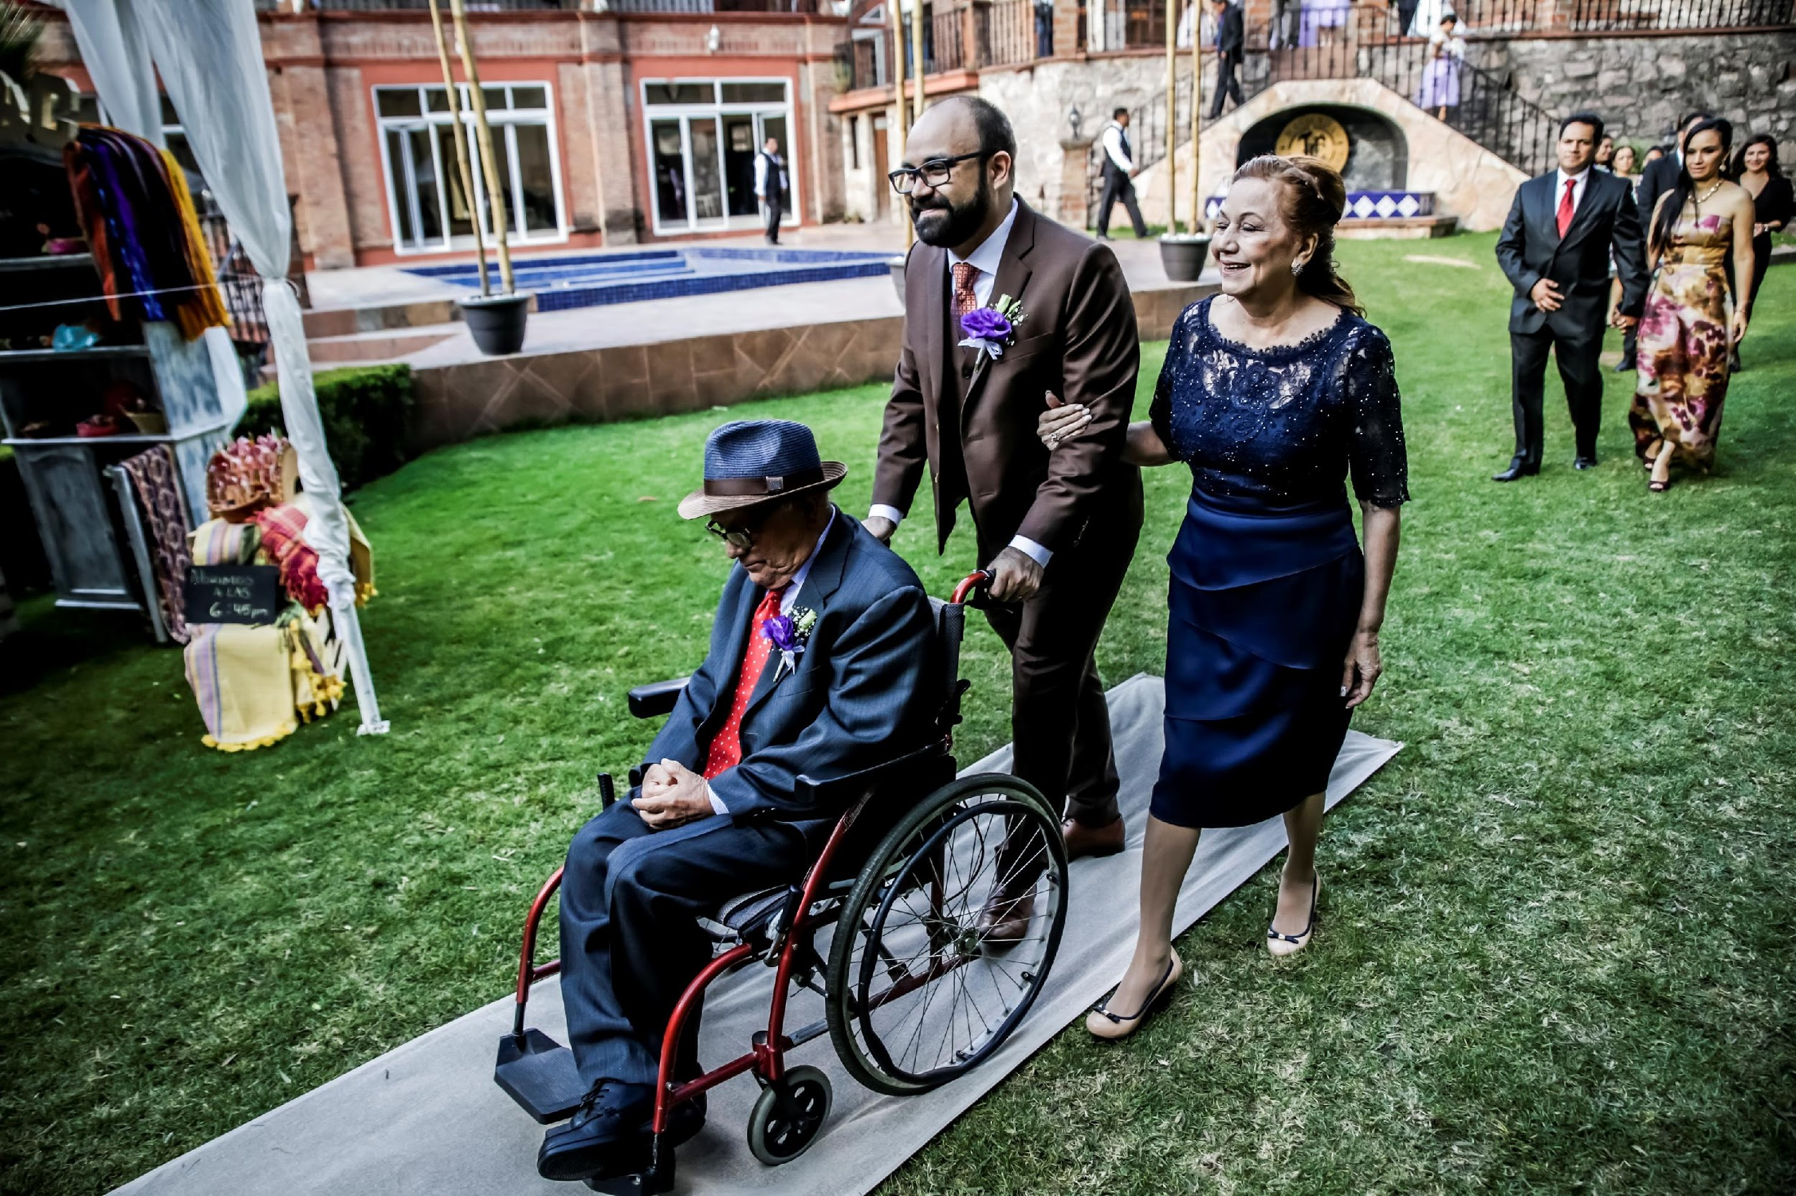
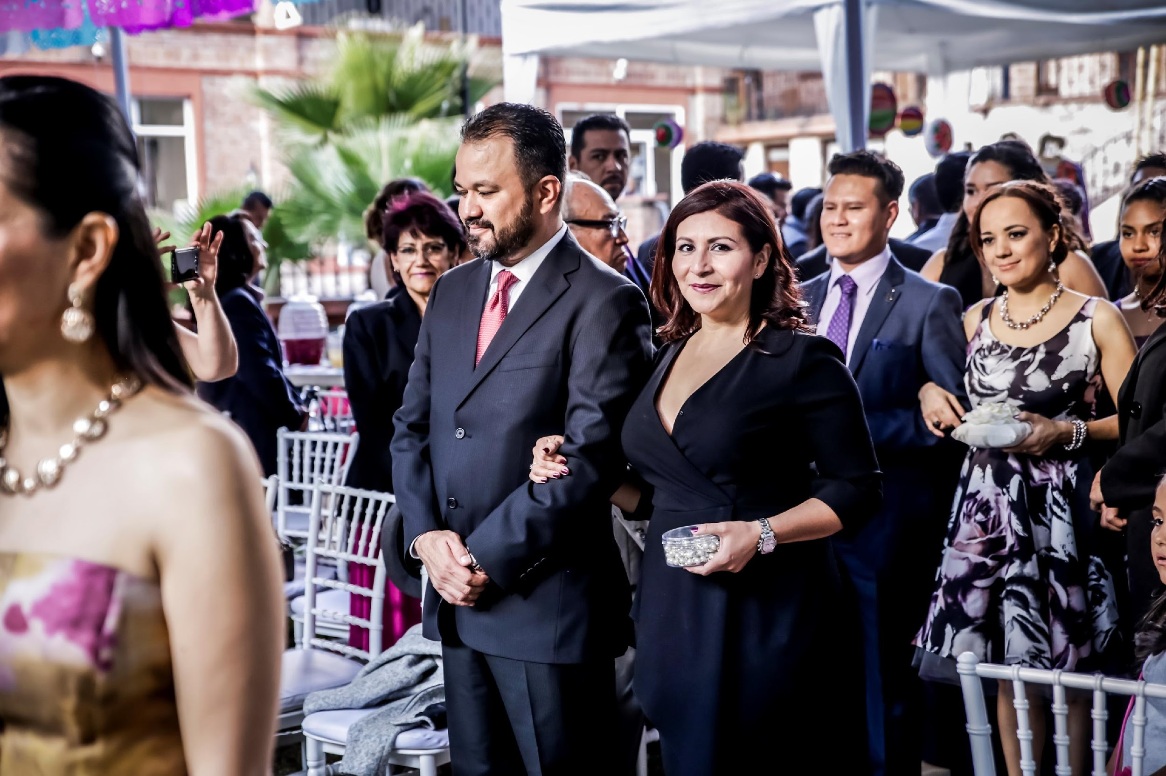
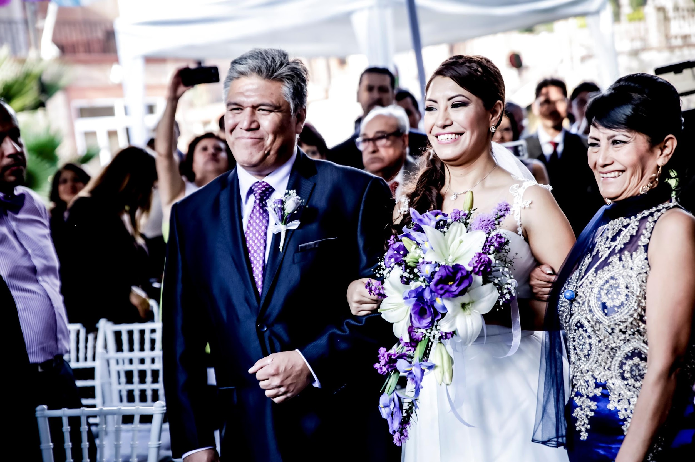
Catholic ceremony
Groom and parents
Generally, the first one to enter to the church / wedding place is the groom with his mom.
The mom of the bride enters with the dad of the groom.
After them, there is a committee of godparents (men and women). These are:
Flower Girls and Ring Bearers
Before the bride comes into the ceremony, the flower girls will be throwing the flower petals.
Finally, the bride comes in, usually with her dad. In my case my mom also made the entrance with us.
Watching Over Godparents
These godparents are the most important ones. They are the ones who will always support and watch over your marriage. It must be a couple that's also been married by the Catholic Church, since they must preach with the example of their marriage.
Godparents
Bride and parents

Slide 5
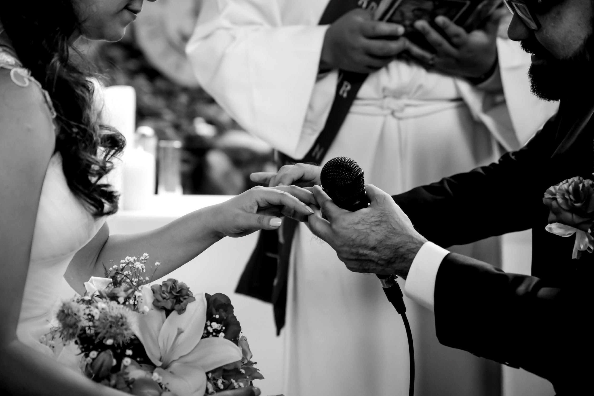
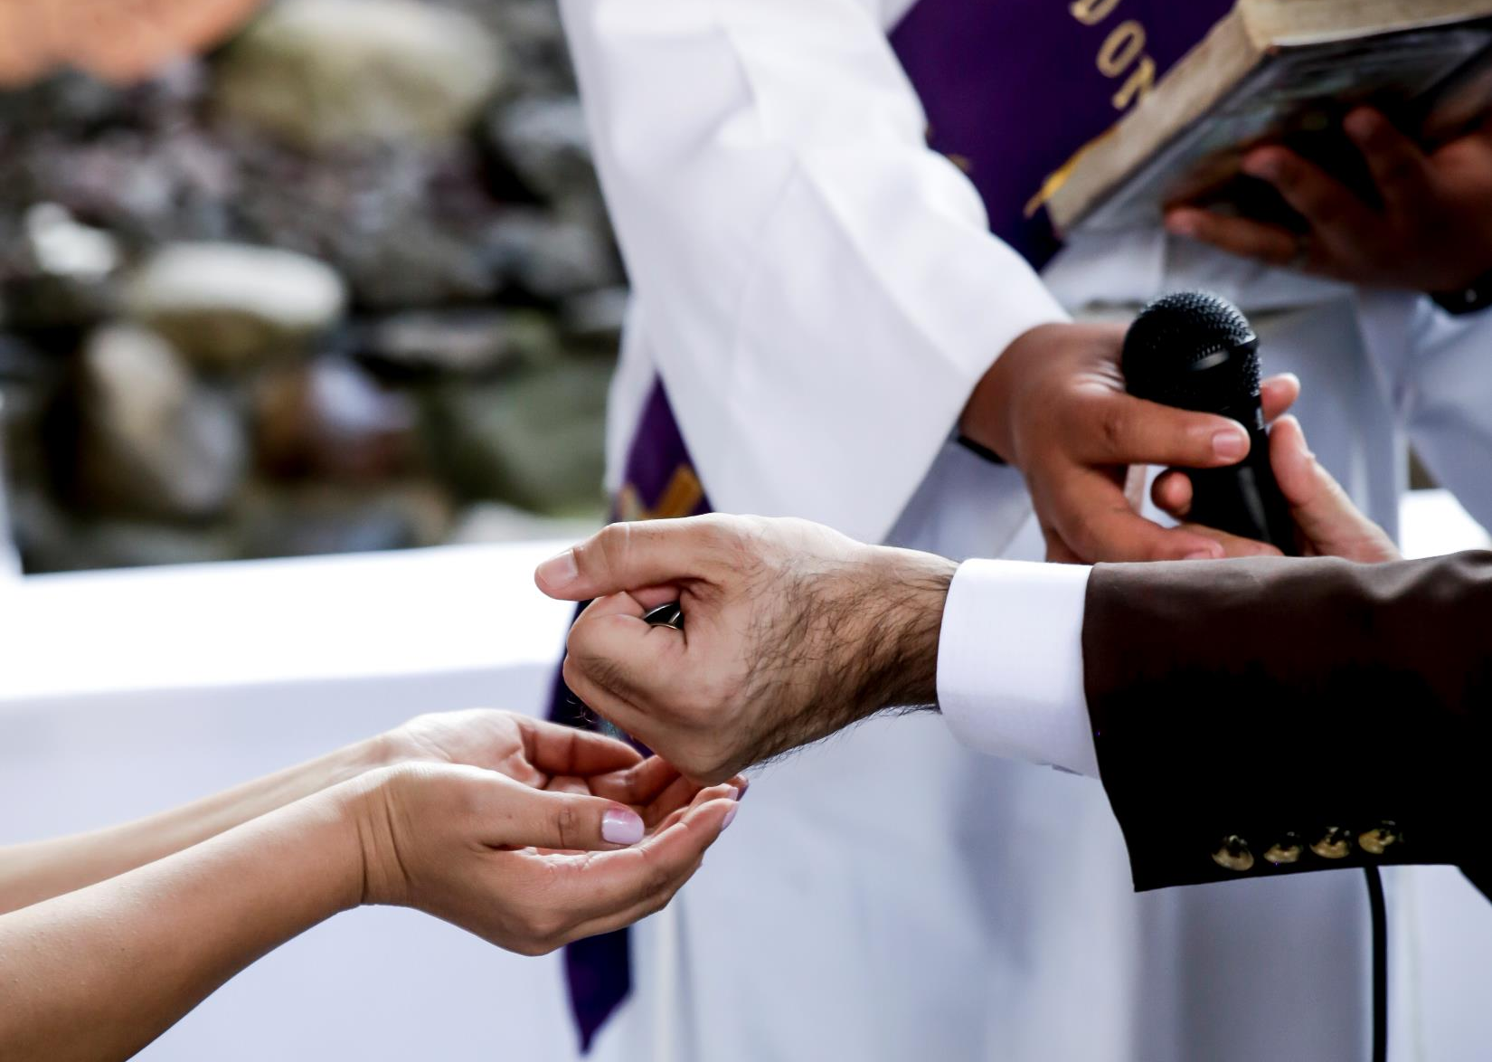
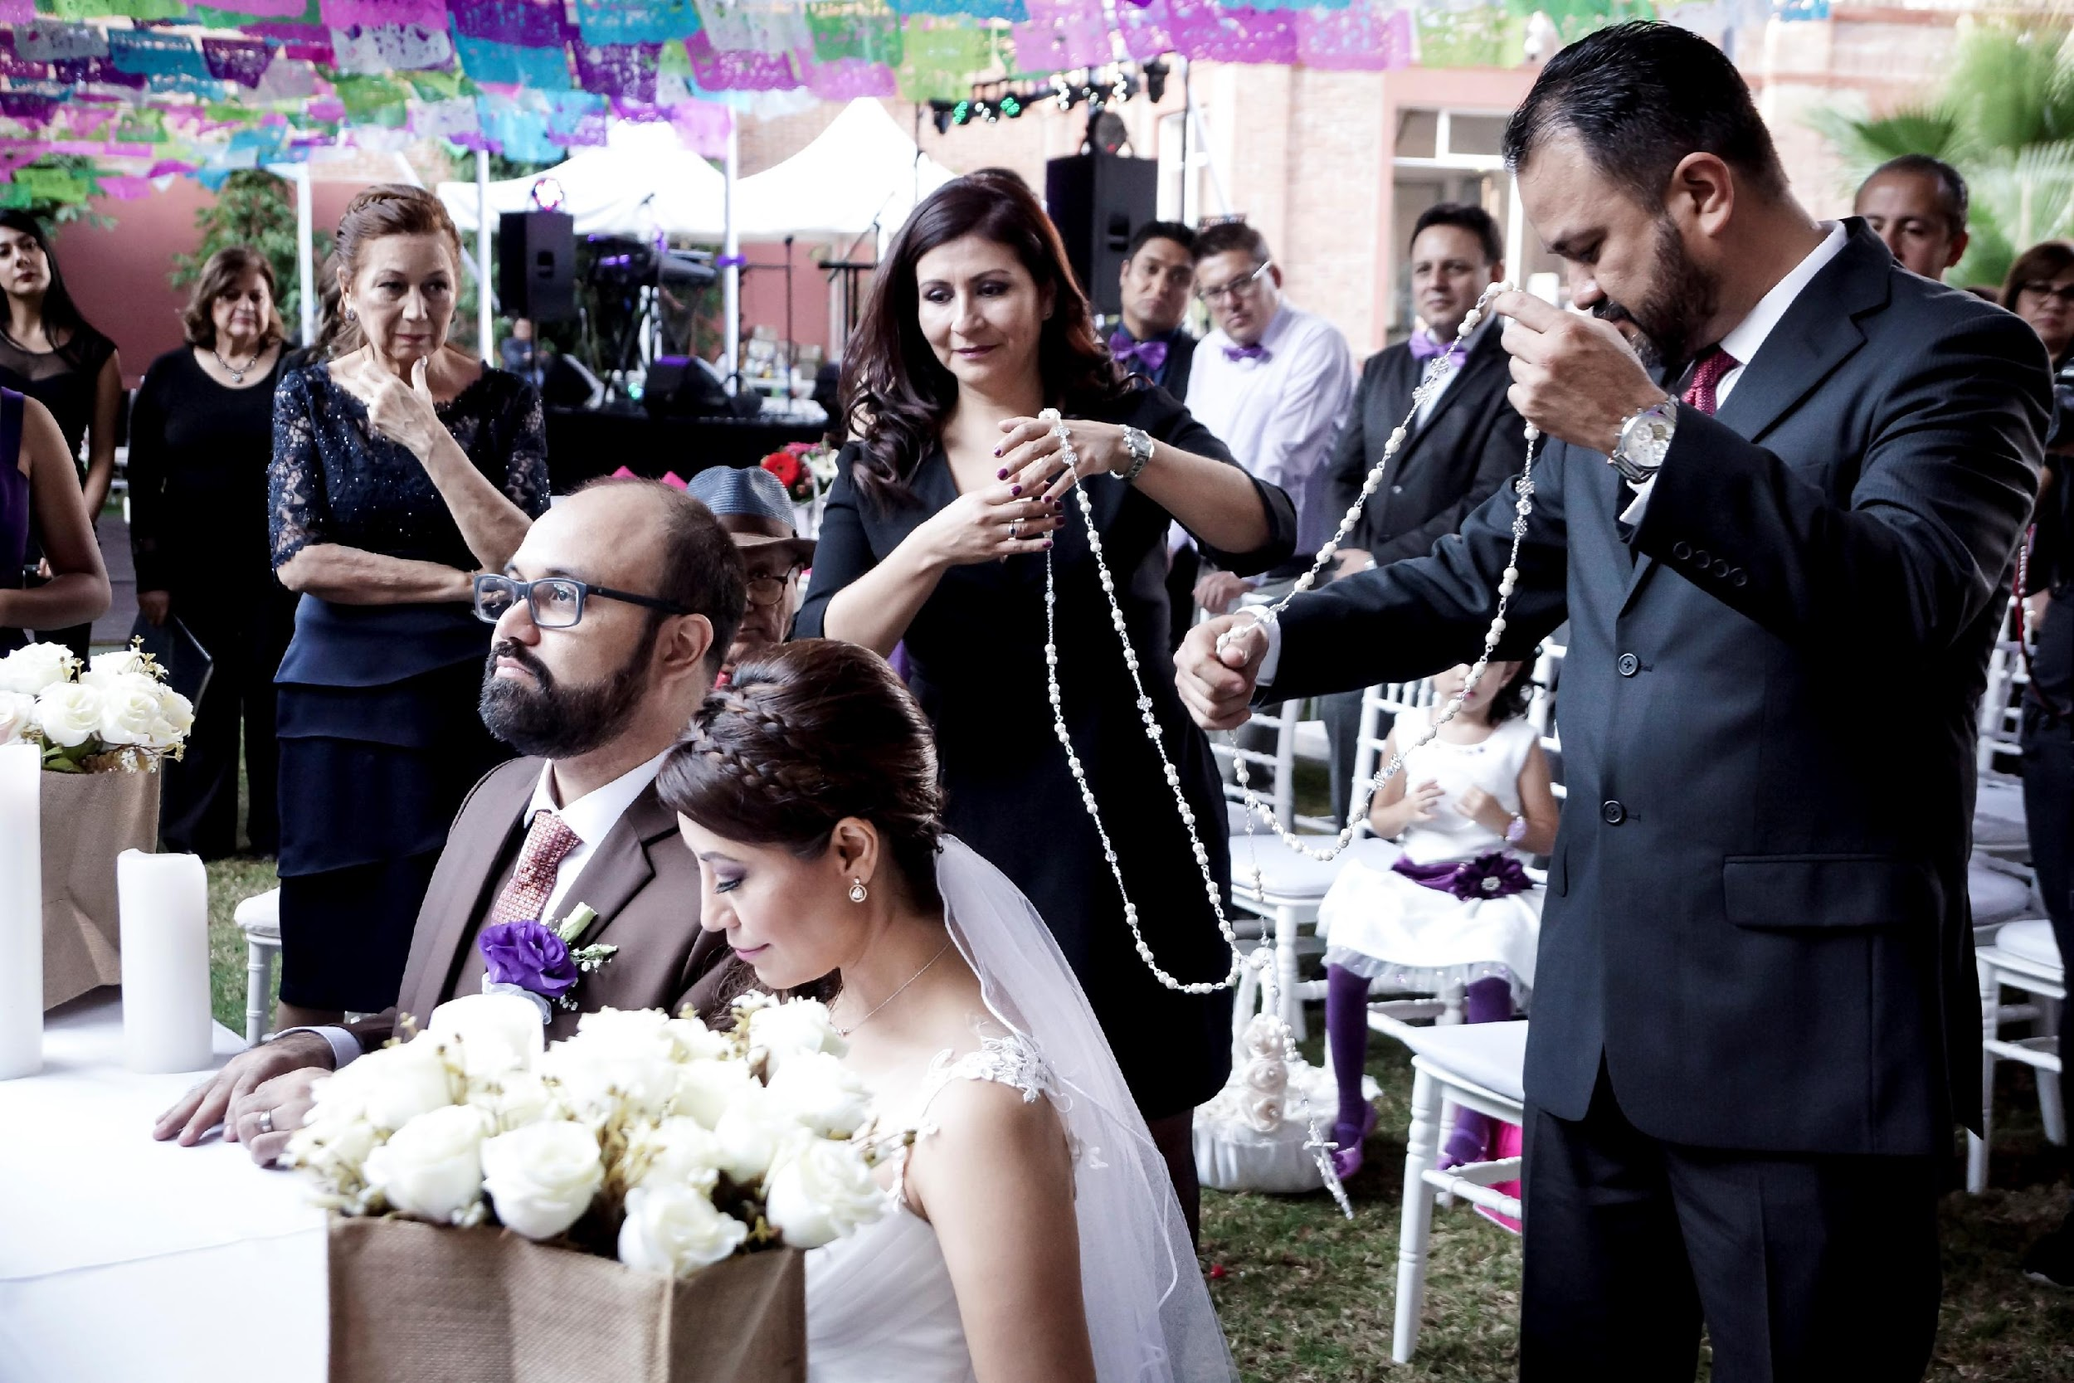
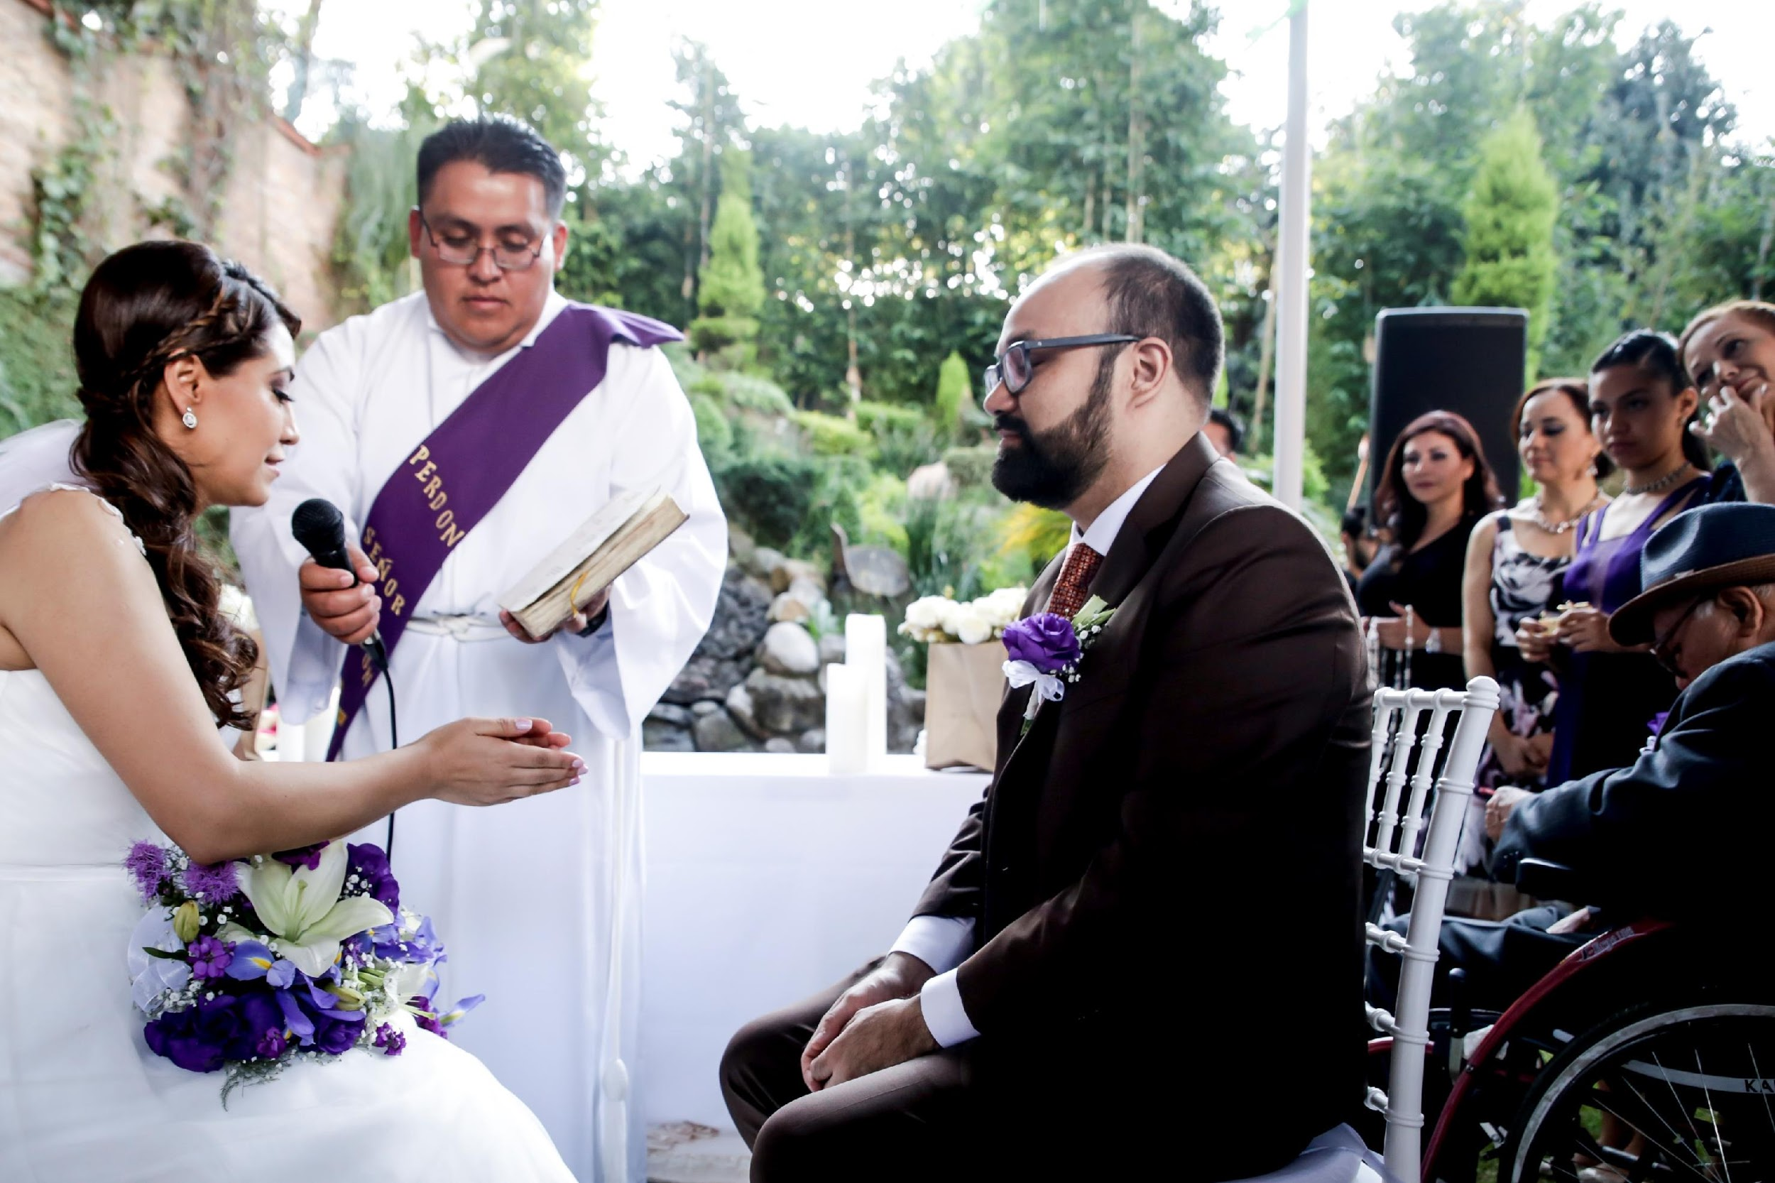
Catholic ceremony
Catholic ceremony
Wedding Cord Godparents
During the ceremony, when the priest indicates it's time for it, the godparents will place the cord around the bride and the groom. When the priest indicates it, they must remove it.
The cord represents the eternal union between the couple and their future offspring.
Rings Godparents
They'll bring them during the ceremony, when the priest indicates that it's the time for them. The rings - round - represent the union of eternal love that will have no end
Unity Coins Godparents
These godparents must take the unity coins out of their box and carefully deliver them to the groom, the groom delivers them to the bride, and viceversa
The coins represent the goods to be shared.
rings
unity coins
wedding cord
unity coins

Slide 6
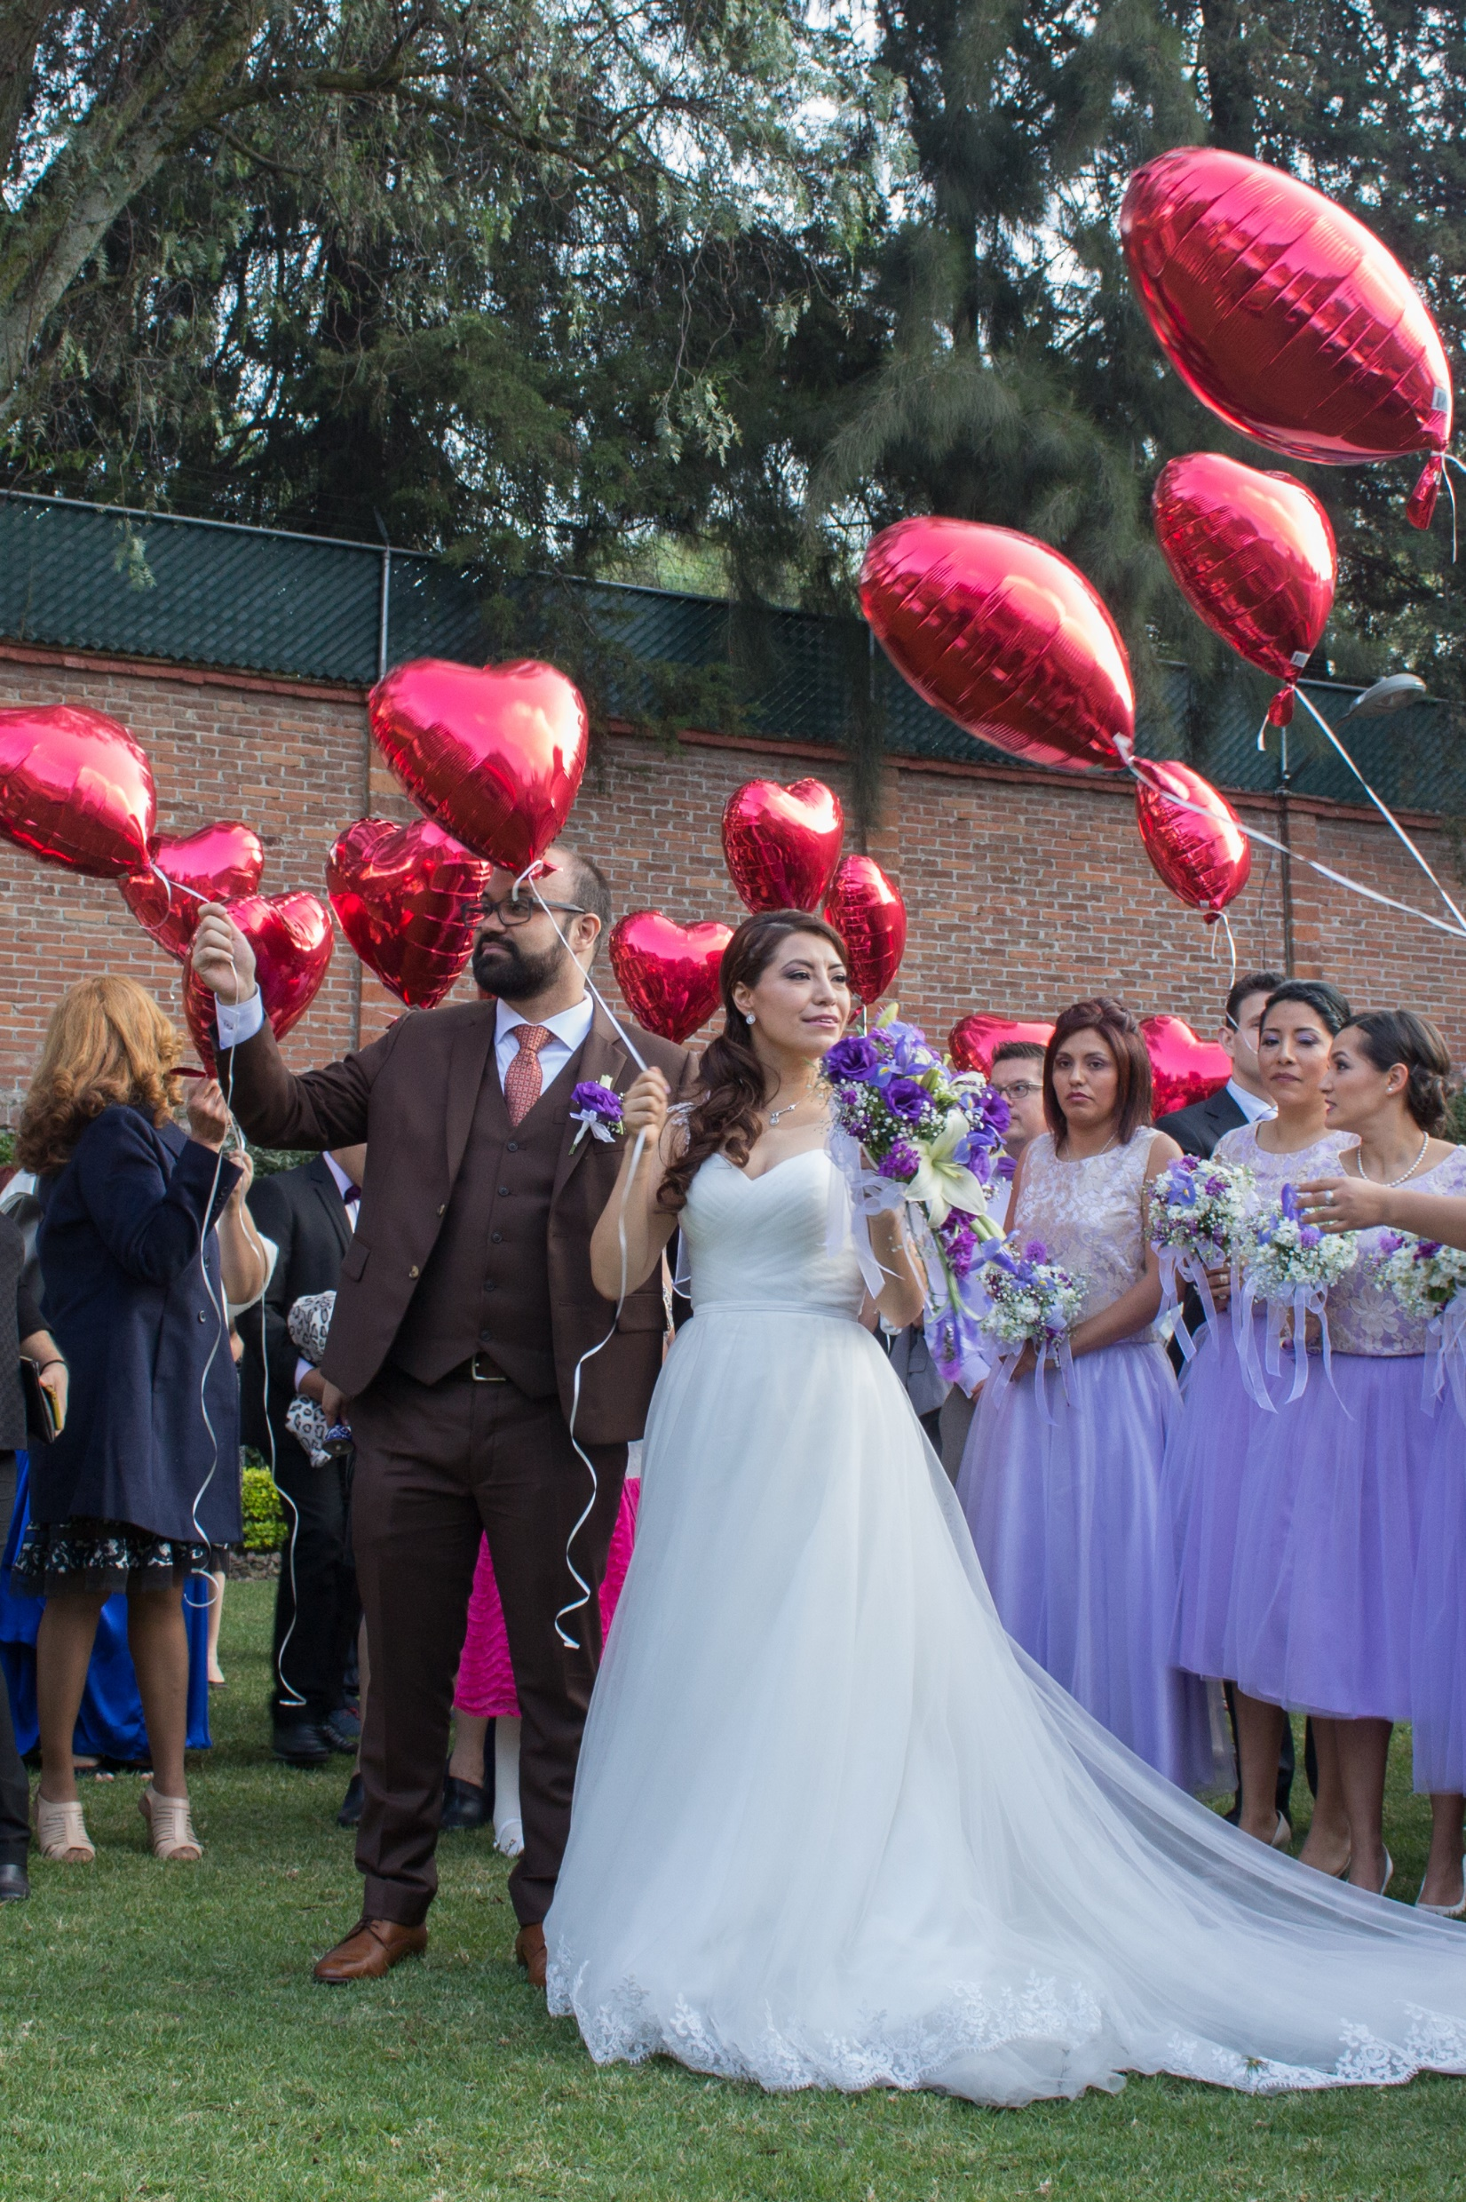
Dress code
The wedding dress is most commonly white.
It is assumed that the colour white was intended to symbolize purity and virginity, though this was not the original intention: it was the color blue that was connected to purity, piety, faithfulness, and the Virgin Mary
At the end of the ceremony
When the couple leaves the church / garden the audience can throw flowers petals, bubbles, balloons , etc as a symbol of the happiness of the couple

Slide 7
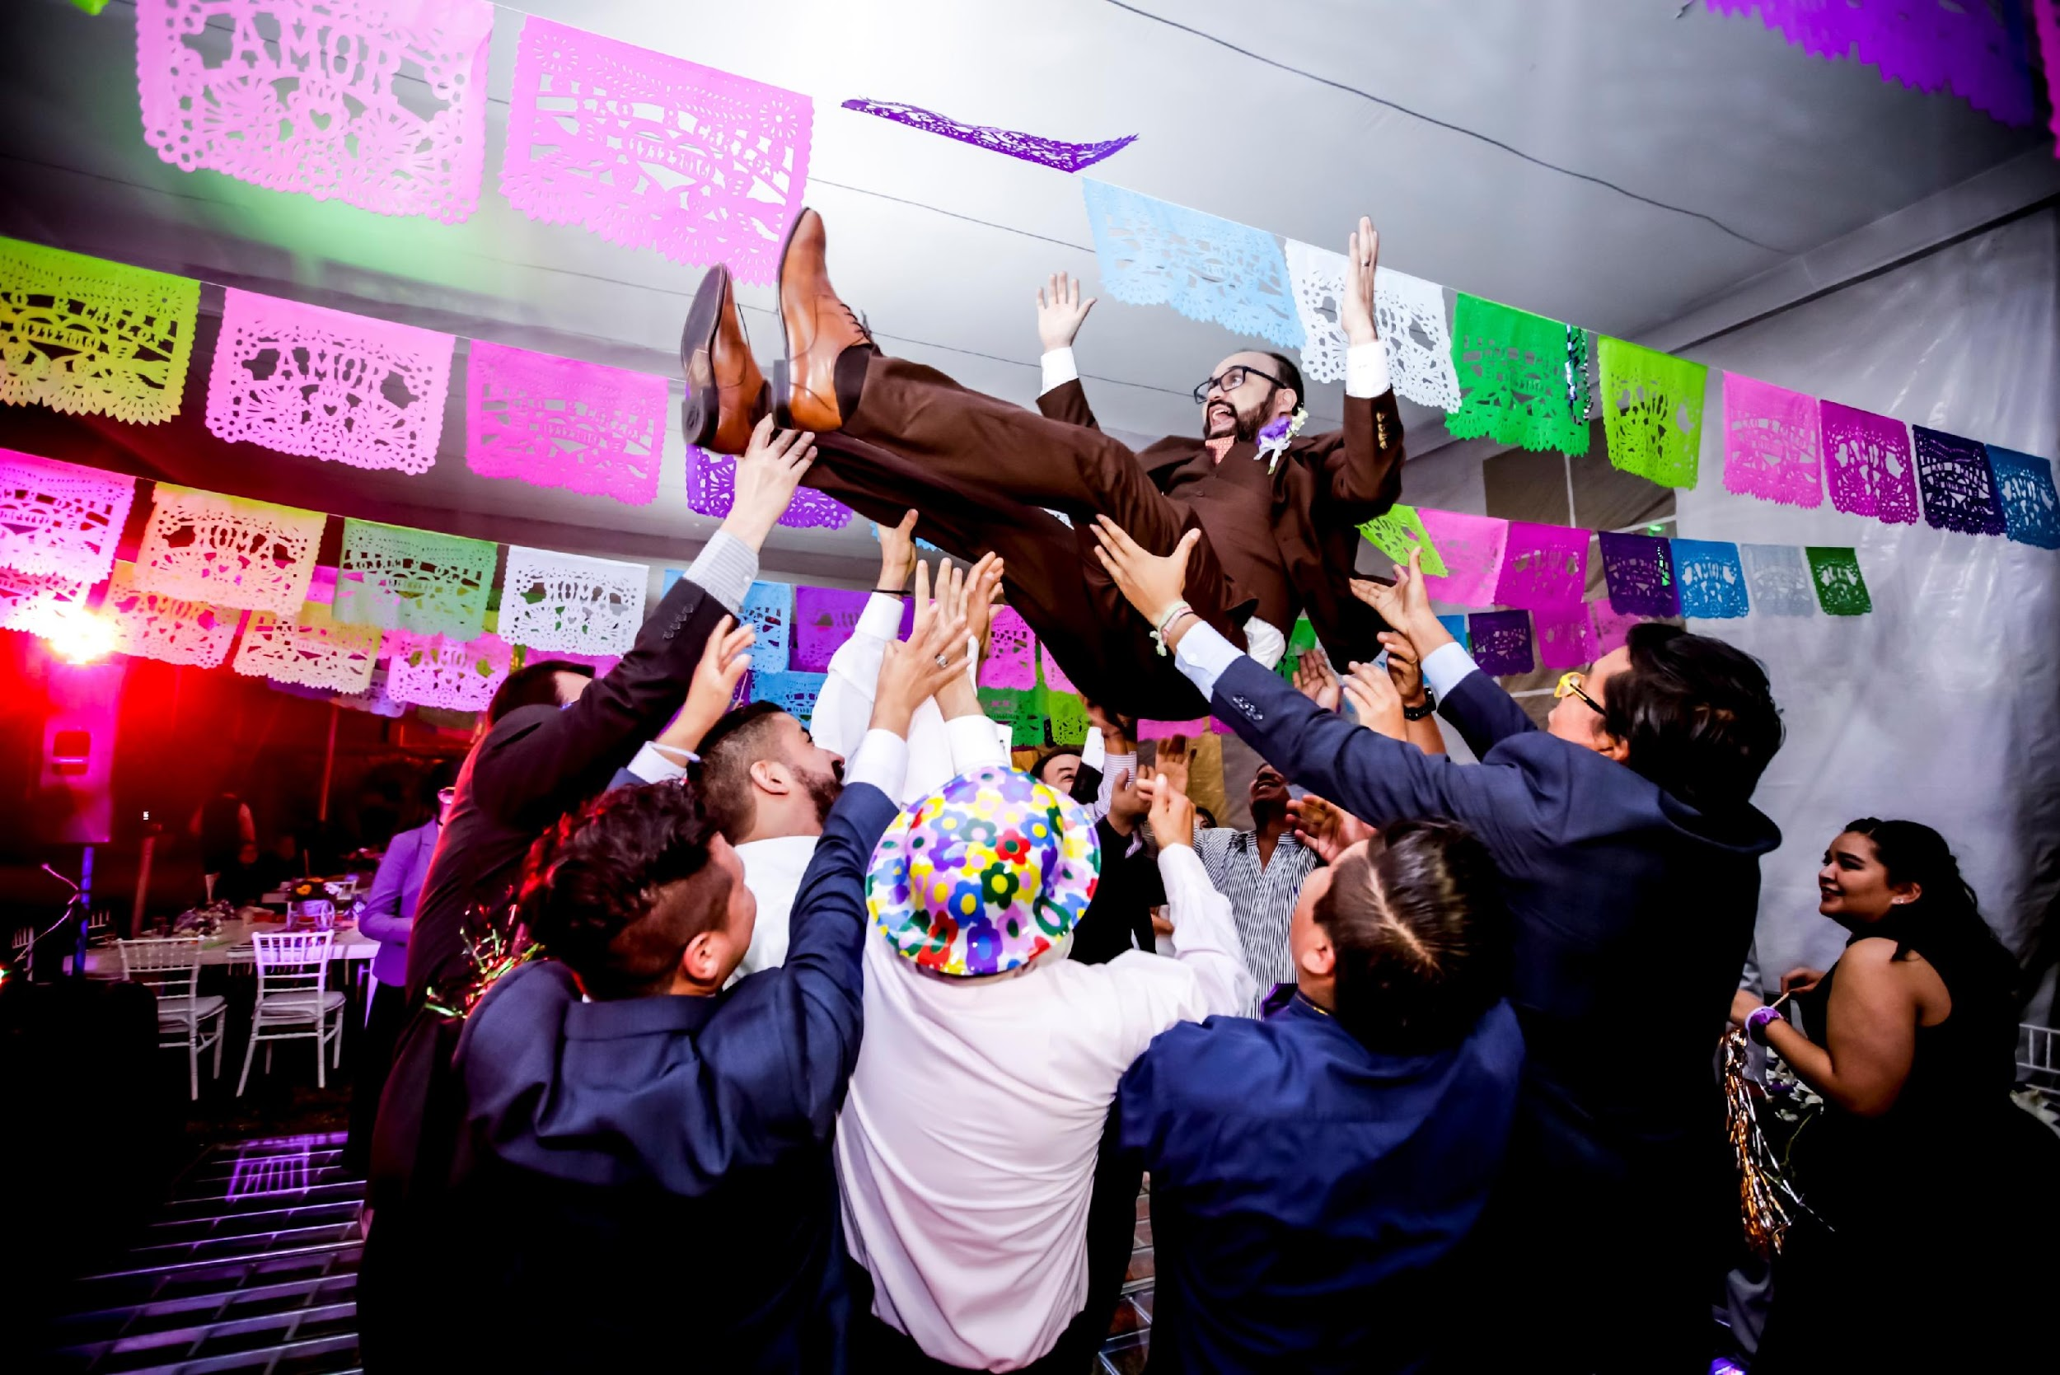
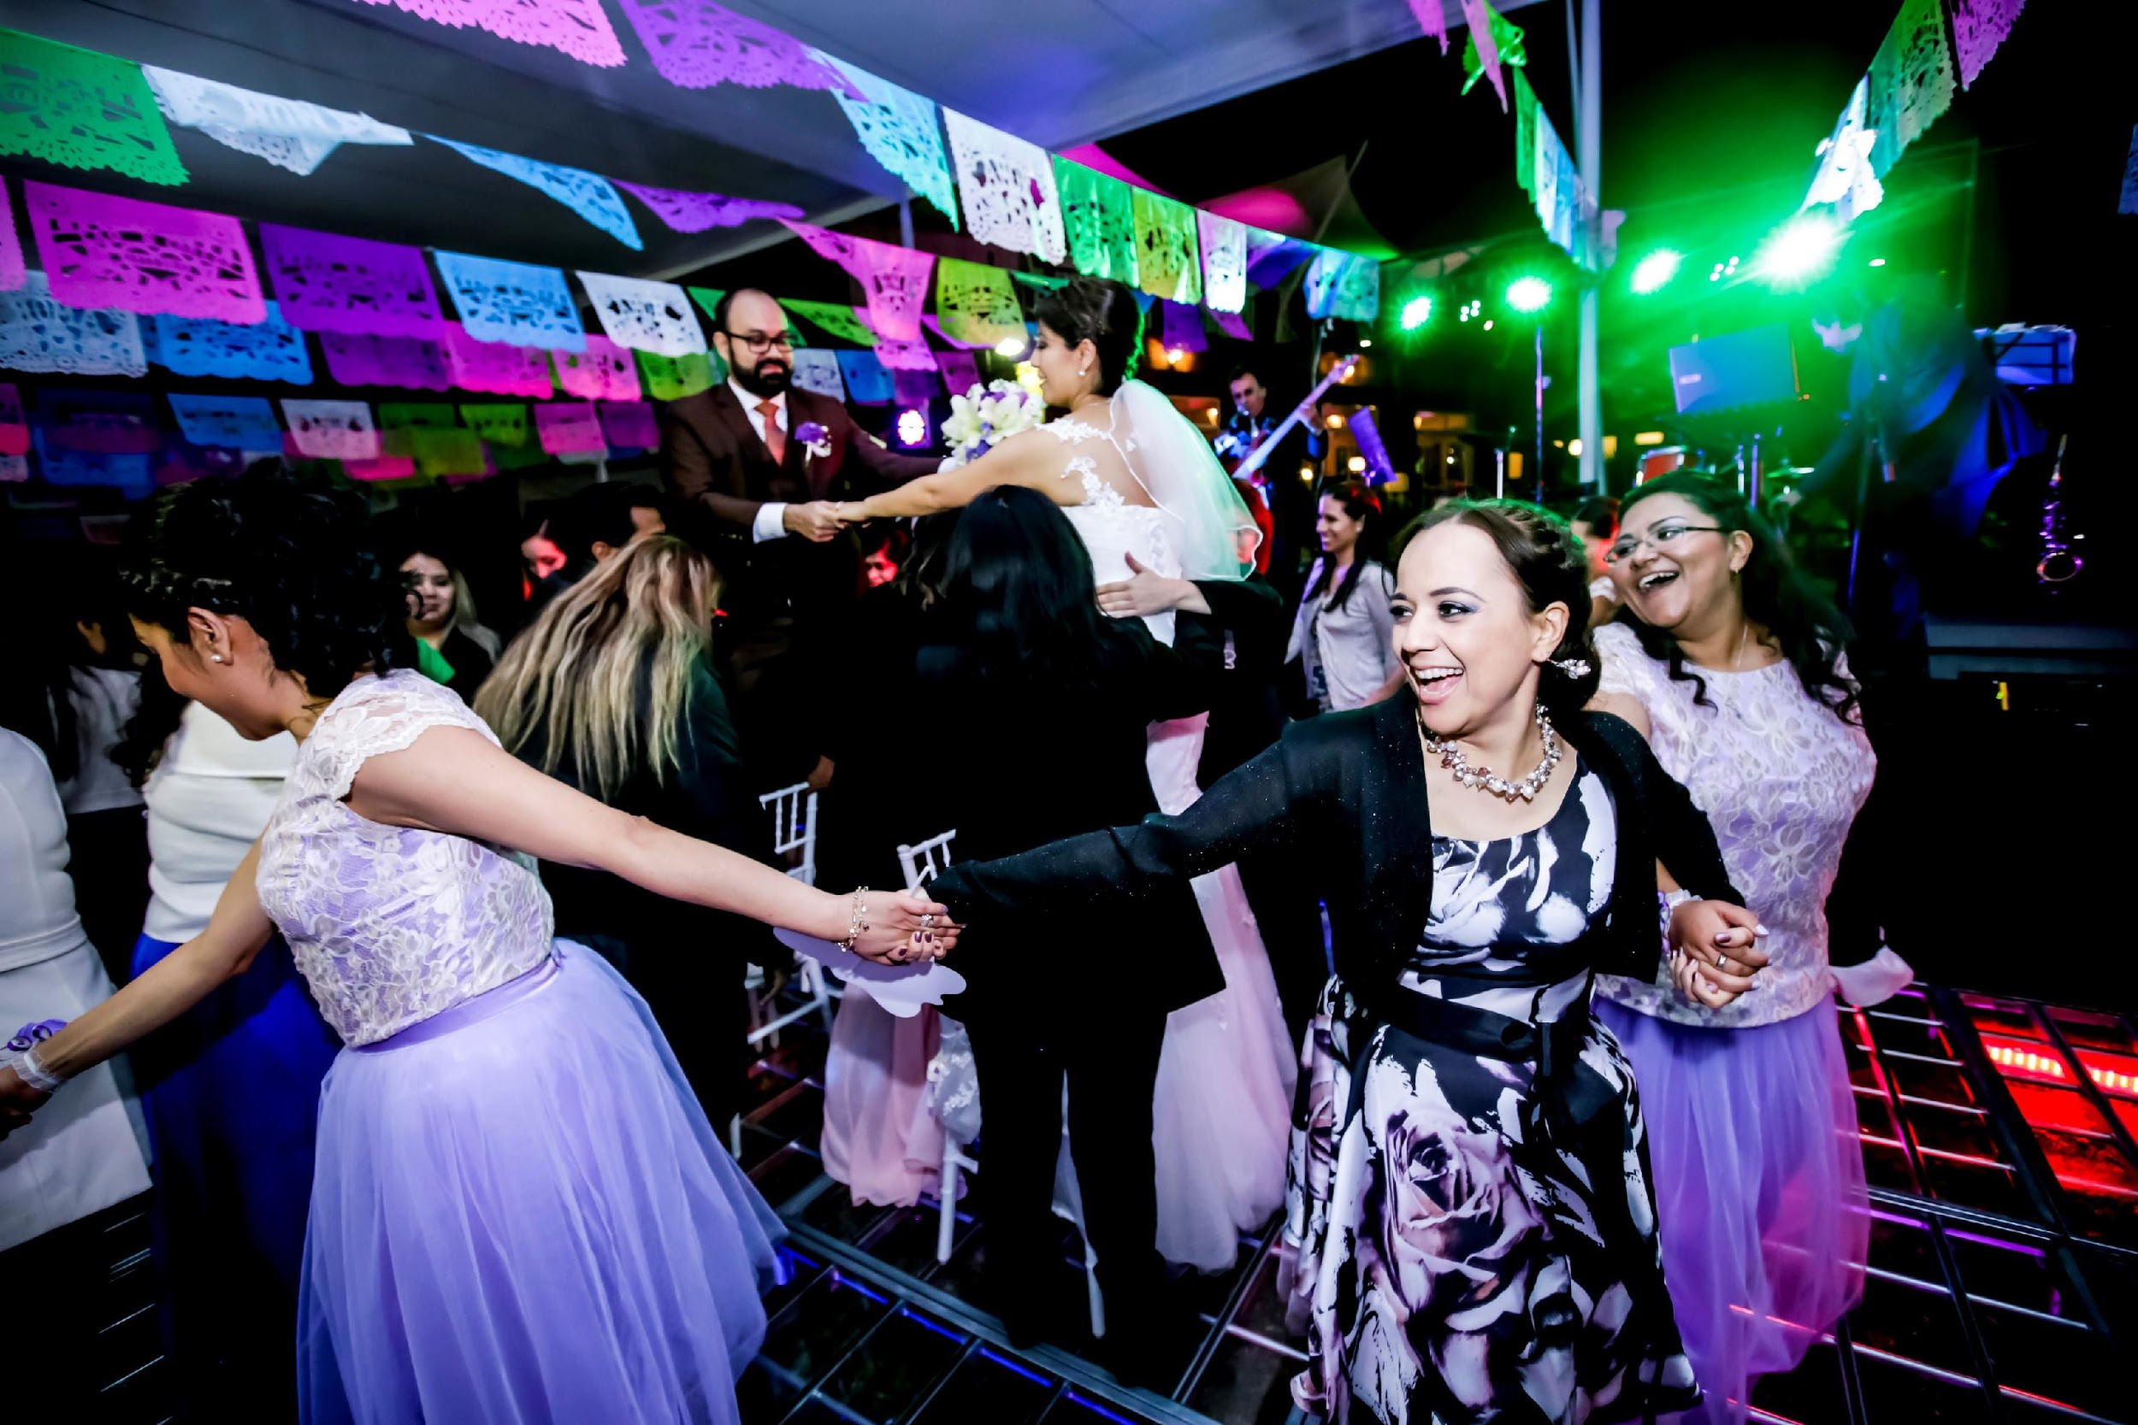
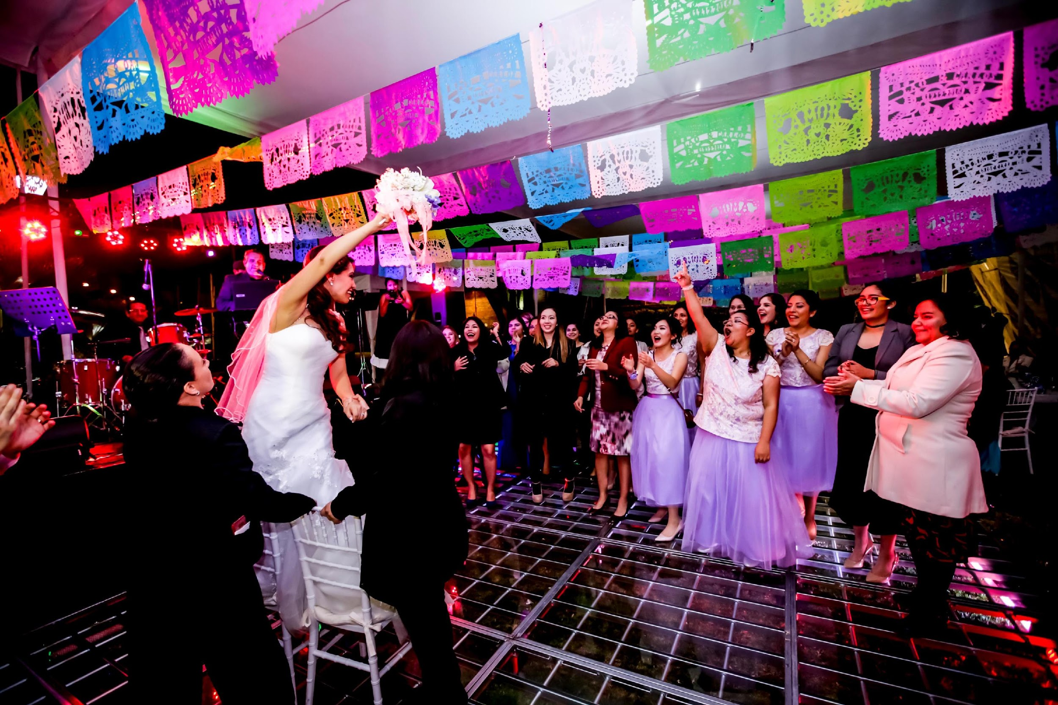
Non-religious traditions
Non-religious traditions
Throwing the groom symbolizes the beginning of a new life in which the groom will be more responsible than when he was single, the beginning of a happy and exciting stage, like a new awakening.
The sea snake dance is derived from a popular children’s game, the dance represents the strength of the newly married couple as they prepare to face life’s challenges together.
The bouquet is thrown to the guests to share the luck of having found their other half and wish them that they found them too. The bouquet represents fertility, flourishing and generosity.
throwing the groom
sea snake dance

